Slide 1

Name: Swathi Chittani
Role: Senior Software Engineer (Front End)
Experience: 9.6 years
Domains: Public Sector & Healthcare
Specialization: Full-stack ReactJS + ASP.NET + SqlServer
LinkedIn: linkedin.com/in/swathi-chittani-11247557

Slide 2
Introduction
Client Portfolio
Current Project Overview – PACSES
Application Architecture
Technical Contributions
Problem-Solving & Performance Optimization
Code Snippets & Best Practices
Agenda

Slide 3


Client Portfolio
Commonwealth of Pennsylvania (CWOPA – PACSES Modernization Project, USA)
Role: Senior Software Engineer (ReactJS, ASP.NET Core, Oracle SQL)
Spearheaded the modernization of the PACSES (Public Assistance Child Support Enforcement System), transforming a legacy mainframe system into a modern web-based architecture to issue benefits to the Pennsylvania citizens
National Health Service (NHS – United Kingdom)
Role: Senior Software Engineer (Frontend Development)
Contributed to the development of web applications for patient management and healthcare analytics under the NHS Digital transformation initiative for maintaining UK citizen Patient Records

Slide 4
Current Project Overview
Architected and Developed a Modern Web Platform
Transformed a legacy mainframe system into a modular, service-oriented web architecture using ReactJS, ASP.NET Core Web API, and Oracle 19c.
Implemented Secure Token-Based Authentication and Authorization
Configured OAuth 2.0 Authorization Code Flow with PKCE using Identity Server for end-to-end secure authentication.
Optimized Performance, Scalability, and Deployment
Enhanced backend performance by replacing cursor-based PL/SQL loops with BULK COLLECT, FORALL, and MERGE-based SQL operations, reducing processing time by 40%.

Slide 5
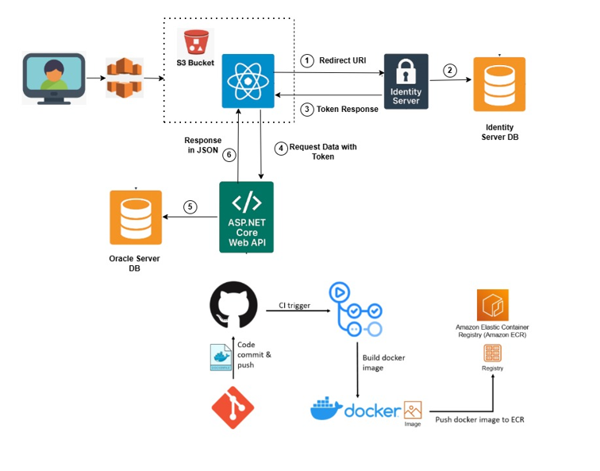
ARCHITECTURE

Slide 6
🧩 PACSES – Benefit Issuance Modernization System Architecture Explanation
1. User Access & Frontend Deployment
The React application is hosted on an AWS S3 bucket and served through CloudFront for global accessibility, caching, and HTTPS support.
When users (state employees, caseworkers, or administrators) access the system via a browser, they are routed to the React application (e.g., https://portal.cwopa.gov/pacses).
2. Authentication via Identity Server
When the user tries to log in, the React app redirects the user (Redirect URI) to the Identity Server (running on port 5000).
The Identity Server is responsible for OAuth 2.0 + PKCE authentication, which securely handles login, MFA, and authorization.
The Identity Server communicates with its own database (Identity Server DB) to validate user credentials, roles, and policies.

Slide 7
3. Token Response Back to React
After successful login, the Identity Server issues tokens —
  Access Token: used for authorization
  Refresh Token: for re-authentication without re-login
These tokens are securely returned to the React application via the Redirect URI callback (e.g.,
https://localhost:3000/auth/callback).
The React app stores the tokens.
4. Data Requests to ASP.NET Core Web API
The React app now includes the Bearer Token in each HTTP request header and makes API calls to the backend (https://localhost:7081/api/...).
These APIs are part of the ASP.NET Core Web API application, which is secured with JWT Bearer Authentication.
The API validates the token using the Identity Server’s public key before processing the request
5. Backend Integration with Oracle Database
Once authentication succeeds, the Web API performs business logic and data operations by connecting to the Oracle Server DB.
The API retrieves or updates data using optimized PL/SQL procedures, MERGE operations, and BULK COLLECT
for high-performance data processing.
This database contains all benefit issuance, accounting, and case-related data for PACSES.

Slide 8
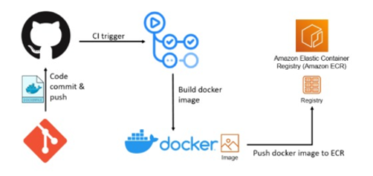
6. Response Back to Frontend
The Web API returns results to the React frontend in JSON format.
The React UI dynamically renders the data into interactive dashboards, forms, and reports.
Example: When the user checks “Benefit Issuance History,” the API returns the relevant client data in JSON, and the React UI displays it in a table or chart.
7. CI/CD & Deployment Pipeline
Code is developed locally, pushed to GitHub, and triggers a CI/CD pipeline.
The pipeline:
  Builds the ASP.NET Core Web API Docker image.
  Pushes the image to AWS Elastic Container Registry (ECR).
  Deploys the containerized API to AWS ECS with Fargate (serverless container hosting).
This ensures automated, scalable, and version-controlled deployments.
The React app (frontend) is also built and deployed to S3 using a similar GitHub Actions pipeline.

Slide 9
Key Technologies Used
Frontend: ReactJS, Redux, Material UI
Backend: ASP.NET Core 6, C#, REST APIs, Swagger, Serilog
Database: Oracle 12c (with PL/SQL optimization)
Authentication: Identity Server 4, OAuth 2.0 with PKCE
Cloud & DevOps: AWS S3, ECS, ECR, Fargate, GitHub Actions, Docker
📊Best Practices
Used Authorization Code + PKCE for SPA auth (no implicit flow)
Suggested SonarQube integration in CI for security & quality gates to detect and fix code smells, unused imports, and inefficiencies.
Centralized telemetry (Sentry / Application Insights) for errors & traces
Pendo Analytics integration to track React pages/components that users visit the most.
Enforce linting, unit tests, and coverage in CI before merge
Harden headers: CSP, HSTS, X-Content-Type-Options

Slide 10
Code Snippets: Pendo Analytics
<script>
(function(apiKey){
(function(p,e,n,d,o){
var v,w,x,y,z;
o=p[d]=p[d]||{};
o._q=[];
v=['initialize','identify','updateOptions','pageLoad','track'];
for(w=0,x=v.length;w<x;++w)(function(m){
o[m]=o[m]||function(){
o._q[m===v[0]?'unshift':'push']([m].concat([].slice.call(arguments,0)));
};
})(v[w]);
y=e.createElement(n);
y.async=!0;
y.src='https://cdn.pendo.io/agent/static/'+apiKey+'/pendo.js';
z=e.getElementsByTagName(n)[0];
z.parentNode.insertBefore(y,z);
})(window,document,'script','pendo');
})('YOUR_PENDO_API_KEY');
</script>

Slide 11
Code Snippets: Harden Headers
app.Use(async (context, next) =>
{
var csp = string.Join(" ",
"default-src 'self';",
"script-src 'self';",
"style-src 'self' 'unsafe-inline';",
"img-src 'self' data:;",
"font-src 'self';",
"connect-src 'self';",
"frame-ancestors 'none';"
);
context.Response.Headers["Content-Security-Policy"] = csp;
context.Response.Headers["X-Content-Type-Options"] = "nosniff";
context.Response.Headers["X-Frame-Options"] = "DENY";
context.Response.Headers["Referrer-Policy"] = "strict-origin-when-cross-origin";
await next();
});

Slide 12
Performance Optimization
Frontend Optimizations:
Implemented code-splitting and lazy loading using React.lazy and Suspense.
Used dynamic imports to load modules on demand.
Applied React.memo, useMemo, and useCallback to prevent unnecessary re-renders.
Preferred async/await + Promise.all for parallel, resilient calls
Integrated Light house audits to track Largest Contentful Paint, Time to Interactive, Cumulative Layout Shift
DB Optimizations:
Query Optimizations
Added custom column-level flags to indicate pre-validated records.
This significantly reduced repeated validation queries and eliminated unnecessary database round-trips.
Replaced row-by-row operations with FORALL (for batch INSERT/UPDATE) and BULK COLLECT (for high-volume data retrieval), improving throughput and reducing execution time dramatically.
Added Strategic Indexing & Removed Unused Indexes
Fine-Tuned SQL Execution Plans

Slide 13
Thank you

